Slide 1


Introduction to Docker
And Containerisation

Slide 2



Course : Mastering DevOps
Lecture On : Introduction to Docker and containerisation
Instructor: Dipesh Garg

Slide 3



Docker Overview and Installation
Docker Image Creation and
Management
Docker Volumes and Multi-Container Deployments

Slide 4
MODULE OVERVIEW:
CONTAINERIZATION USING DOCKER
Evolution of Docker
Creation and Management of Docker Images
Deployment of Docker Container
Managing Container Data
Multi-Container Application Deployment

Slide 5


Docker Overview and Installation
Docker Image Creation and
Management
Docker Volumes and Multi-Container Deployments

Slide 6
SESSION OVERVIEW:
DOCKER OVERVIEW AND INSTALLATION
Docker Journey
Containerization vs Virtualization
Docker Vocabulary
Docker Architecture
Docker Installation

Slide 7
Introduction to Docker

Slide 8
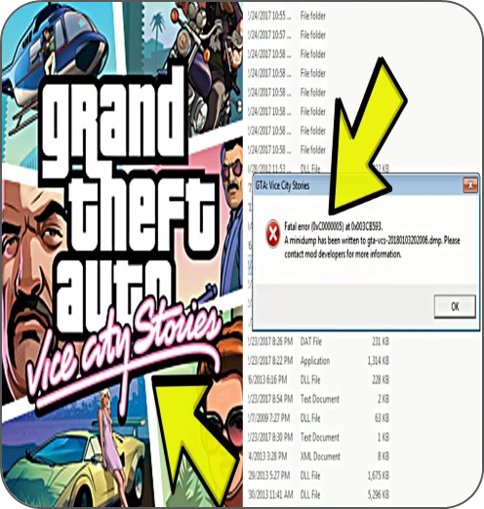
PROBLEMS TO SOLVE
Remember GTA Vice City Installation?
Download the installer
Run the installer
Error message during installation
Troubleshoot the issue
Re-run the installer
Another issue arises
Source: https://images.app.goo.gl/cSnrBcWHSRwBnmqk9

Slide 9

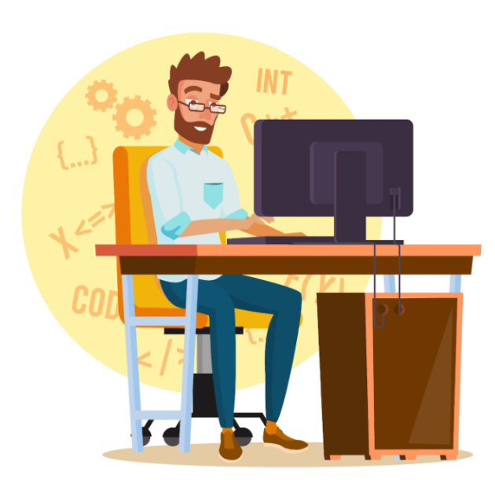
Maybe your
machine is not the same as mine
There is a problem with
your application. It is not
working at our end
But it works
fine at my end
Developer
Operations

Slide 10
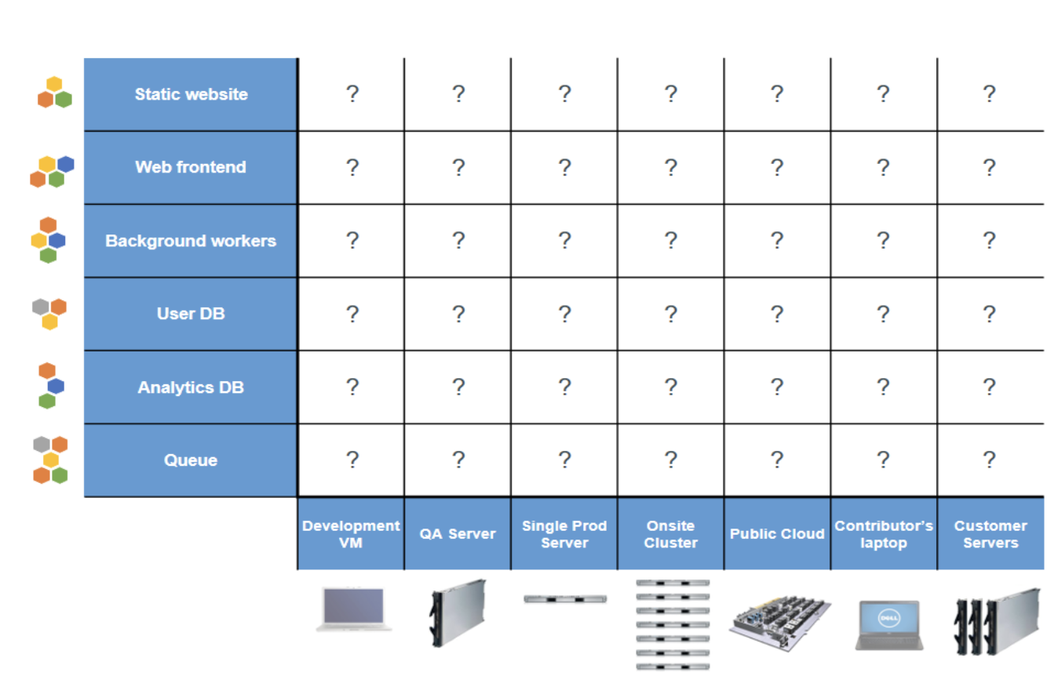
THE MATRIX FROM HELL
Static website | ? | ? | ? | ? | ? | ? | ?
Web frontend | ? | ? | ? | ? | ? | ? | ?
Background workers | ? | ? | ? | ? | ? | ? | ?
User DB | ? | ? | ? | ? | ? | ? | ?
Analytics DB | ? | ? | ? | ? | ? | ? | ?
Queue | ? | ? | ? | ? | ? | ? | ?
 | Development VM | QA Server | Single Prod Server | Onsite Cluster | Public Cloud | Contributor’s laptop | Customer Servers
Running applications with any combination of hardware/operating systems, libraries, and dependencies is a challenge
Setting up an appropriate Dev/Prod/QA environment takes a lot of time

Slide 11
WHAT IS VM?
A virtual machine works like a virtual computer system
It is a virtual environment with its own resources
For example, CPU, memory, etc.
These resources are created on a physical hardware system
The hypervisor creates a separate workspace for each Guest OS
What are VMs used for?
  Running multiple operating systems on a single piece of hardware
  Experimenting with a new operating system (OS), including beta releases
  Creating and deploying cloud-based applications
  Improving hardware utilization

Slide 12
BENEFITS OF USING VM
Cost savings
Agility and speed
Lowered downtime
Scalability
Security

Slide 13

Docker? Is it required
when I have a virtual machine (VM)?

Slide 14
WHAT IS DOCKER?
Open-source containerization platform
Used to create, manage, and deploy containers
Docker containers - platform-independent
Can run in any environment, such as Windows, Linux, Cloud, etc.
Bundles application code, system libraries, and other dependencies in a single executable package
Lightweight, open, and secure

Slide 15
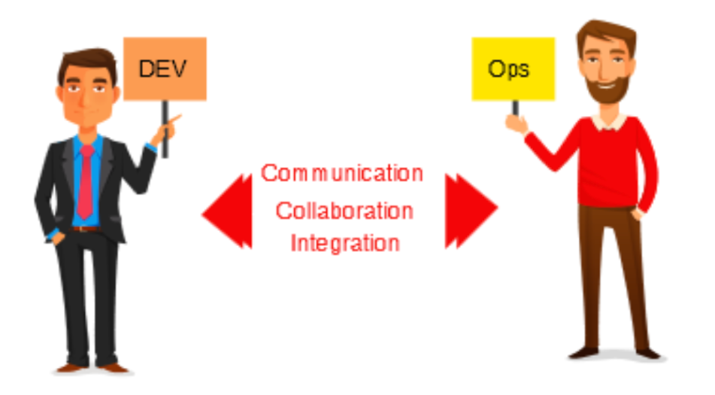
ADVANTAGES OF DOCKER
Docker containers are portable and sharable and, thus, solve the problems related to collaborations between development and operations teams of an organization, enabling faster software delivery
Development
Staging
Production
A Docker container swiftly moves through these stages in a DevOps pipeline

Slide 16
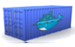
DOCKER ELIMINATES THE MATRIX FROM HELL
Static website
Web frontend
Background workers
User DB
Analytics DB
Queue
 | Development VM | QA Server | Single Prod Server | Onsite Cluster | Public Cloud | Contributor’s laptop | Customer Servers
Docker addresses the “matrix from hell”
problem
It decouples an application from the underlying operating system and hardware
Docker packages an application with its environment and all of its dependencies
It thus solves the “missing dependency problem”

Slide 17
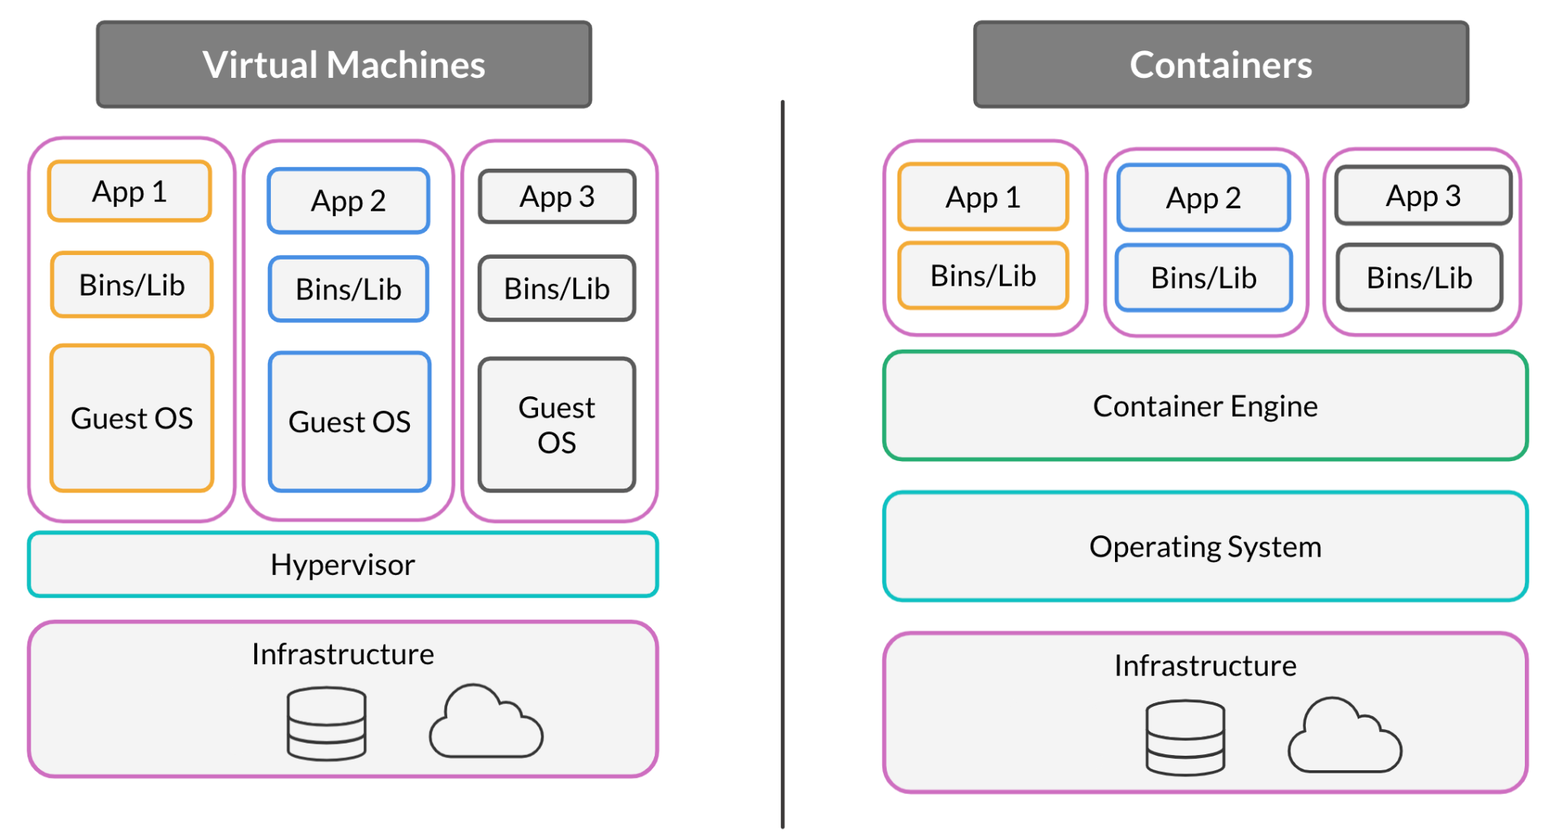
VM VERSUS CONTAINER
Virtual Machines
Containers
App 1
App 2
App 3
App 1
App 2
App 3
Bins/Lib
Bins/Lib
Bins/Lib
Bins/Lib
Bins/Lib
Bins/Lib
Guest OS
Guest OS
Guest OS
Container Engine
Hypervisor
Operating System
Infrastructure
Infrastructure

Slide 18
Containers
Virtual Machines
App 1
App 2
App 3
Bins/Lib
Bins/Lib
Bins/Lib
Guest OS
Guest OS
Guest OS
Hypervisor
Hypervisor
Operating System (Host OS)
Infrastructure
Infrastructure

Slide 19
VM VERSUS CONTAINER
Docker
Virtual Machines (VMs)
Boot-time
Boots in a few seconds
Takes a few minutes for VMs to boot
Runs on
Make use of the execution engine
Make use of the hypervisor
Memory efficiency
No space needed to virtualize, hence less memory
Requires entire OS to be loaded before starting the surface, so less efficient
Isolation
Prone to adversities, as no provisions for isolation systems
Interference possibility - Minimal because of efficient isolation mechanism
Deployment
Easy as only a single image, containerized can be used across all platforms
Comparatively lengthy, as separate instances are responsible for execution
Usage
Complex usage mechanism consisting of both third-party and docker-managed tools
Tools easy to use and simpler to work with

Slide 20
VIRTUAL MACHINES AND CONTAINERS
Virtual Machines
Virtual Machines
Container
Container
Container
Container
App 1
Bins/Lib
App 2
Bins/Lib
App 3
Bins/Lib
App 4
Bins/Lib
Docker
Docker
OS
OS
Hypervisor
Infrastructure

Slide 21
USE CASES: VM
Virtual Machine
It includes multiple applications on a single server
The applications require all the resources and functionalities of the OS
The applications need complete isolation and security (since containers provide process-level isolation)
Virtual machines (VMs) should be preferred when network components require high performance

Slide 22
USE CASES: CONTAINERS
Container
It is used to maximize the number of applications running on a server
The applications will be lightweight, and the start-up time will be in milliseconds
The applications should be infrastructure-independent
Containers are more cost-efficient than VMs

Slide 23
Docker Vocabulary

Slide 24
DOCKER VOCABULARY
Docker Image
Comprises multiple layers that define your container; image is a static read-only property
Docker Container
Runtime instance of an image; read-write by default
Docker Engine
Comprises components that are responsible for building and containerizing the application
Registry Service
Cloud site of docker where images are stored; can be public or private

Slide 25
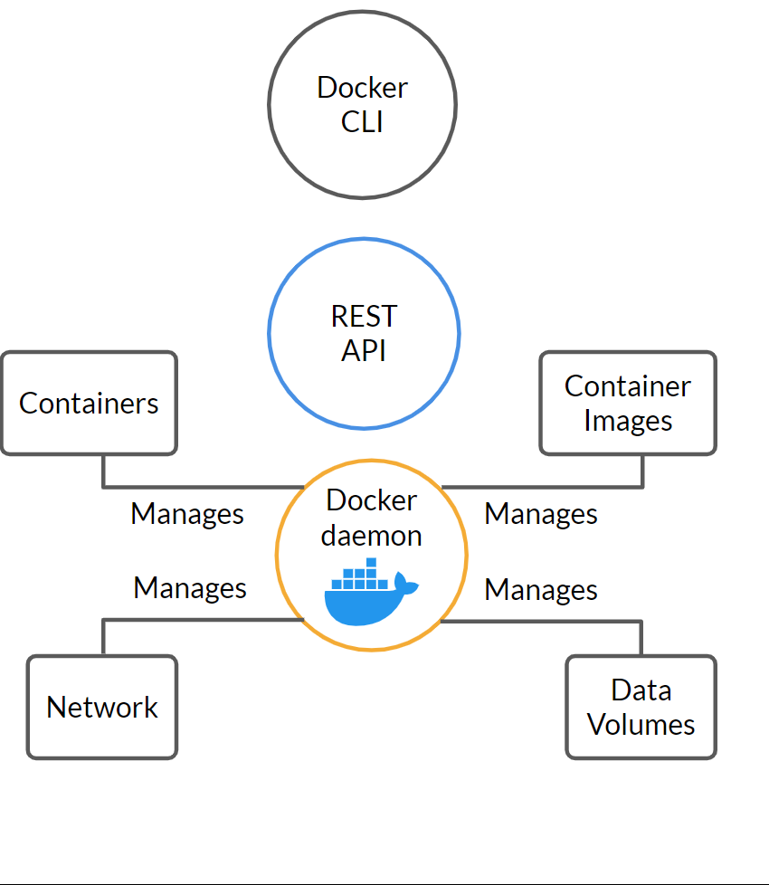
DOCKER ENGINE COMPONENTS
Docker CLI
REST API
Containers
Container Images
Docker Daemon
Manages
Manages
Manages
Manages
Network
Data
Volumes

Slide 26
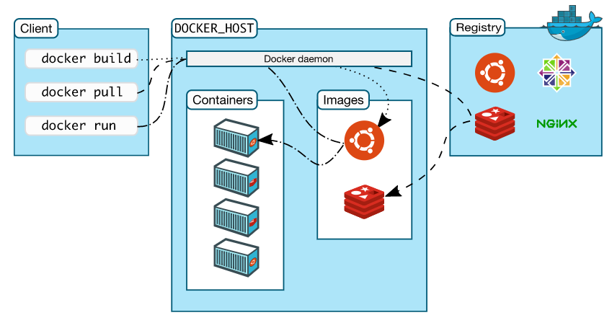
DOCKER ARCHITECTURE

Slide 27
DOCKER ARCHITECTURE
01
Docker daemon: Runs on Docker host and handles all requests from Docker client
02
Docker client: Interacts with Docker daemon using CLI commands
03
Docker registry: Storage for Docker images, which facilitates the sharing of docker images
04
Docker objects: Includes Docker images, containers, and volumes

Slide 28
DOCKER INSTALLATION
Docker Installation
Windows version below 10
Windows version 10
Linux
MacOS
Requires Docker Toolbox
Requires Docker Desktop
Requires Docker Engine
Requires Docker
Desktop

Slide 29
DOCKER INSTALLATION
All operating systems support Docker tool
The installation instructions for Docker may be found here: https://docs.docker.com/engine/install/
The Docker version command can be used to check the installed version
Docker info can be used to display system-wide information regarding the Docker installation
The displayed information includes the kernel version and the number of containers and images

Slide 30
DEMO 1: DOCKER INSTALLATION
Installing Docker over EC2 instance
Managing Docker as a non-root user

Slide 31


Docker Overview and Installation
Docker Image Creation and
Management
Docker Volumes and Multi-Container Deployments

Slide 32
SESSION OVERVIEW:
DOCKER IMAGE CREATION AND MANAGEMENT
Docker Image
Dockerfile and Instruction
Context-building
Docker Layer
Docker Registry and Tarball
Docker Container Deployment

Slide 33
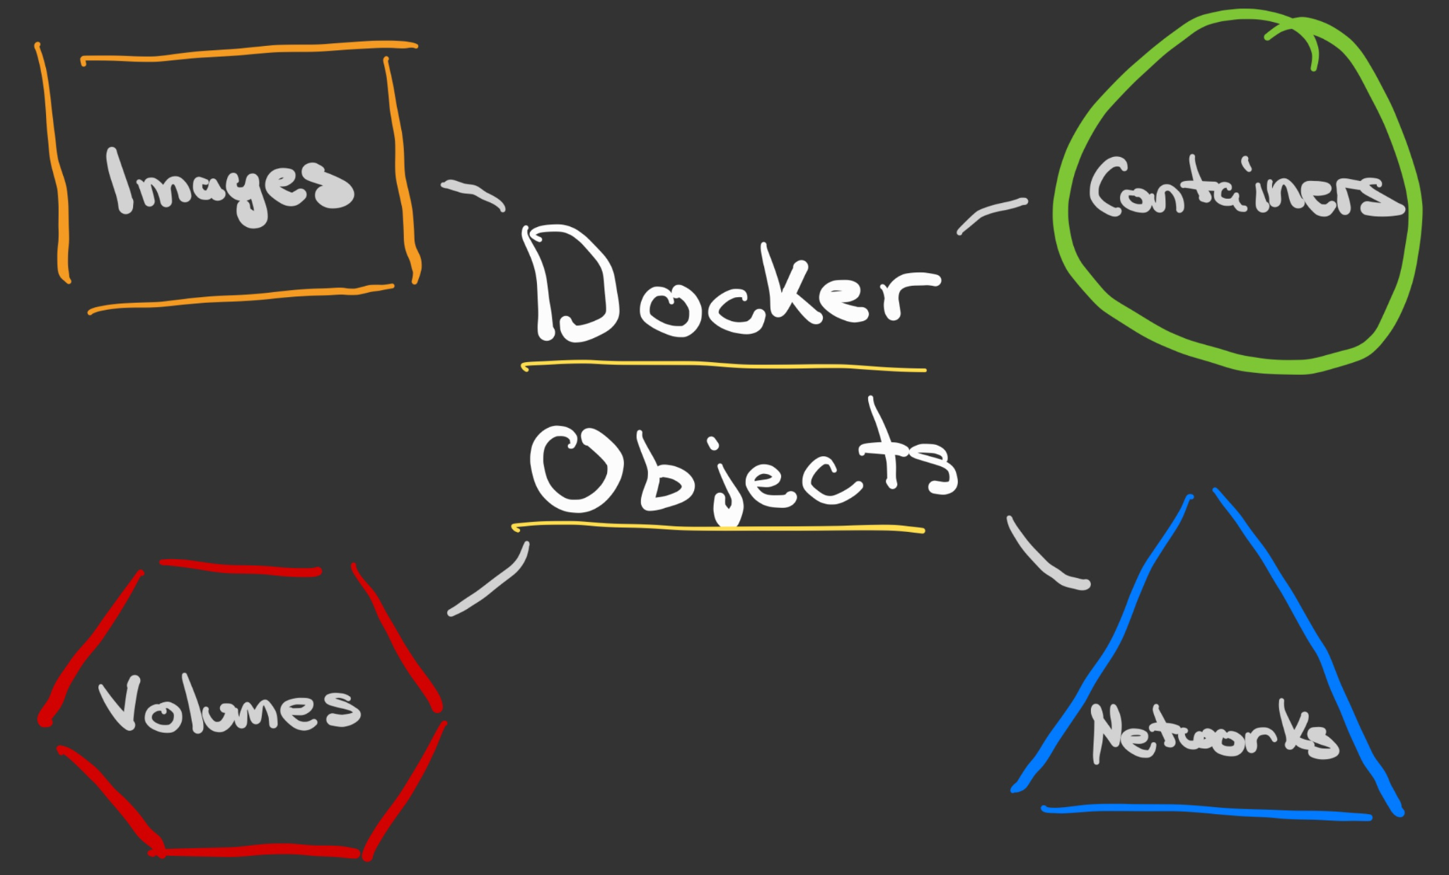
DOCKER OBJECTS
Images
Containers
Networks
Volumes
Plugins
Other objects

Slide 34
DOCKER IMAGE
An image is an instruction file that defines the blueprint of a container
All the requirements such as binaries, runtime, etc. are present in the image
These are similar to the snapshots created in VM environments
A Docker image can be created by any of the following methods:
Dockerfile: A text file that contains a set of instructions that describe how to build an image
Interactive: By saving the state of a running container and creating a customized Docker image

Slide 35
DOCKER IMAGE
Dockerfile Method
Advantages: Clean, repeatable, and compact images; offers easier CI/CD integration and better lifecycle management; helps us have clear documented steps to build an image
Disadvantages: More time-consuming than the interactive method and more difficult for beginners to learn
Interactive Method
Advantages: The simplest and fastest way to construct Docker images; ideal for POC, testing, and analyzing dependencies and processes
Disadvantages: Difficult lifecycle management; requires error-free manual configurations; difficult to have rollbacks

Slide 36
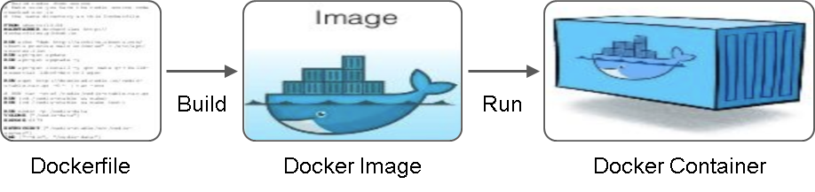
DOCKERFILE
A text document that contains a set of instructions that execute after one another to build an image
The commands include FROM, RUN, CMD, ADD, COPY, ENTRYPOINT, VOLUME, USER and many more.
Dockerfile
Docker Image
Docker Container

Slide 37
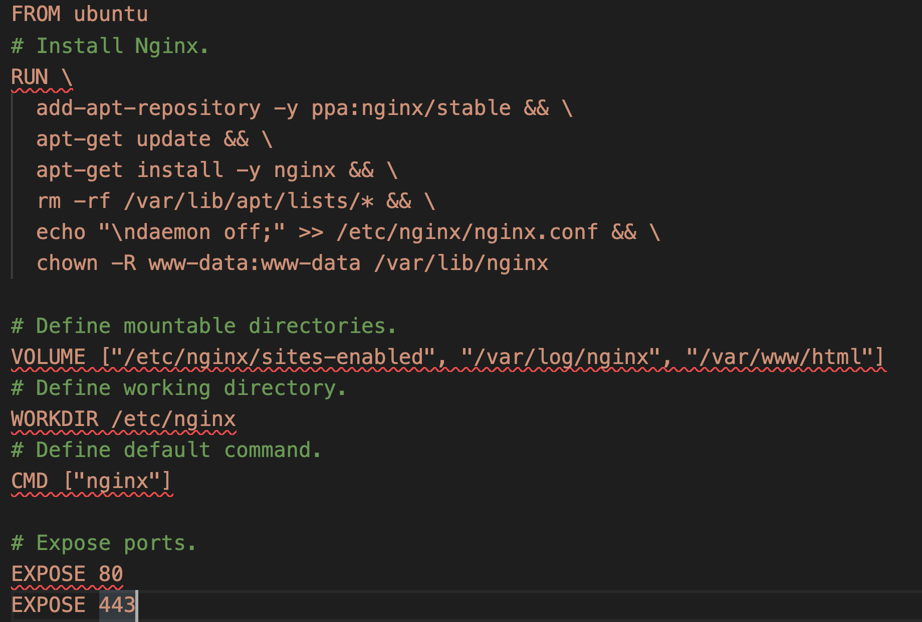
DOCKERFILE INSTRUCTIONS
Command | Purpose
FROM | To specify the parent image
WORKDIR | To set the working directory for any commands that follow in the Dockerfile
RUN | To install any applications and packages required for your container
COPY | To copy over files or directions from a specific location
ADD | As COPY, but also able to handle remote URLs and unpack files
ENTRYPOINT | Command that will always be executed when the container starts
CMD | Arguments passed to the entrypoint
EXPOSE | To define which port through which to access your container application
LABEL | To add metadata to the image

Slide 38
DOCKER BUILD
The following command is used to build an image from Dockerfile:
docker build .
Use the -t flag to set an image name and tag:
Repository Name
Version
Label
docker build –t repository/application: latest .
Build Command
Build Context

Slide 39

DOCKER BUILD CONTEXT
COPY can only access resources available
in the build context
By default, Docker uses the contents of
the directory passed to Docker build as
the build context
When you run Docker build, the CLI
sends the files and folders to build to
the Docker engine
This set of files and folders becomes the
build context
Slowdown will be apparent once you
add files to your working directory that
are not used by your Dockerfile
Linux VM
(Docker Host)
Docker Build
myappimage
(container Image)
Build Context
Myapp (c#)
Dockerfile

Slide 40
DOCKER BUILD OVERFLOW
docker build –t repository/application:latest .
Build command
Build context path
Docker Client
Configuration to define the behavior of the Docker container
Docker CLI acting as client
Docker daemon gets the command from Docker client and builds the image
Docker Image
Create Dockerfile
Docker Server

Slide 41
DEMO 2: CREATING A DOCKERFILE
Writing Dockerfile to create an Nginx docker image
Understanding the use of ADD versus COPY, CMD versus ENTRYPOINT

Slide 42
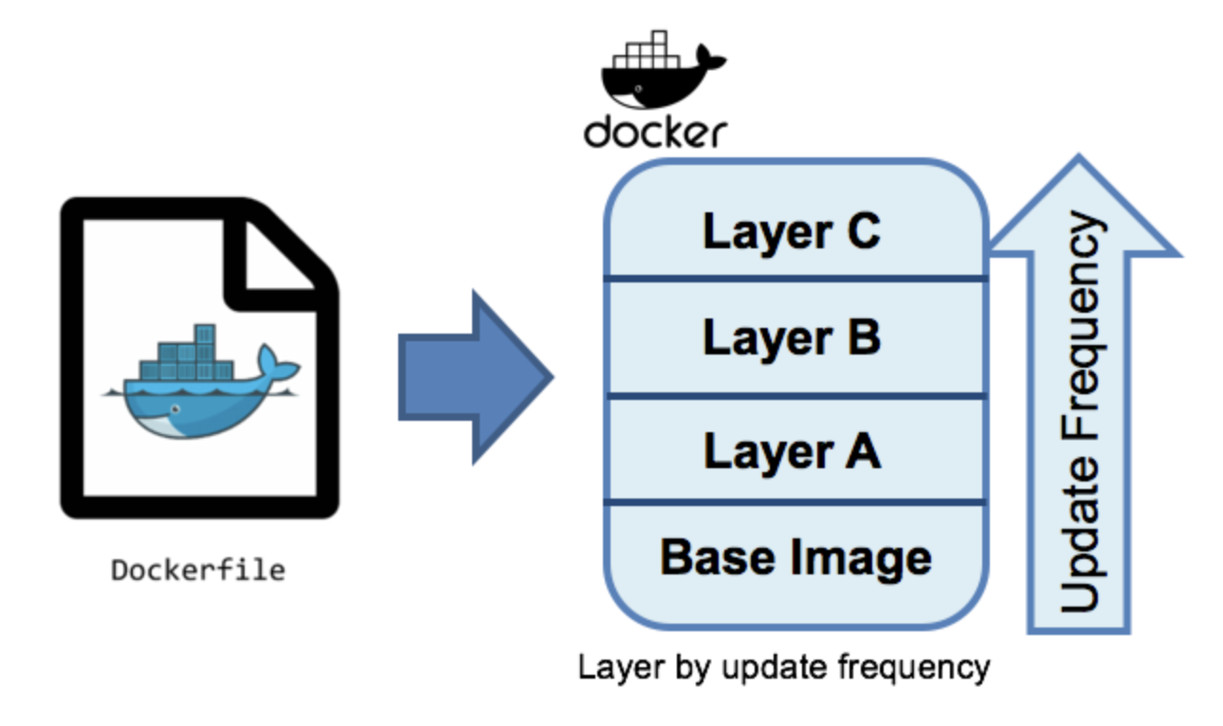
IMAGE LAYERS
Every command you specify (FROM, RUN, COPY, etc.) creates a new layer
This new layer is created based on the previous layer
These layers are generated during the build phase of the image
A random ID is given to each layer during its creation
The Docker history command can be used to view all the layers that make up a Docker image

Slide 43
INTERACTIVE METHOD
The changes made inside a container can be converted into a new image
The container being committed and its processes are paused by default while the image is committed
No data present in volumes are included during the commit operation.
docker commit <CONTAINER_ID> <REPO>/<APPLICATION>:<TAG>

Slide 44
DOCKER IMAGE COMMANDS
docker images
This command lists all the downloaded images in your system
docker rmi <image_id>
This command deletes an image that is not linked to any container
docker build <path_to_docker_file>
This command builds an image from a given Dockerfile
docker history <image_id>
It is used to display all the layers used in image creation/Docker history <image_id>

Slide 45
DEMO 3: DIFFERENT IMAGE COMMANDS
docker images
docker tag
docker build <path_to_docker_file>
docker rmi <image_id>
docker history <image_id>
docker inspect <image_id>
docker system prune -af

Slide 46

SHARING A DOCKER IMAGE
Where can I store a Docker image, and how can I share it with my team members and the operations team?
Developer

Slide 47
DOCKER REGISTRY
A Docker registry is a storage system that holds different tagged versions of Docker images
It is similar to the Git repository, which is used for source code management
It enables the storing and sharing of images
The Docker push command is used to save an image to a remote registry. Similarly, the Docker pull command is used to fetch the image from the remote registry
The registry can be easily integrated with the CI/CD system
Git Repository
CI/CD Build Server
Docker Registry
Deployment Host
Code commit initiates the CI/CD pipeline
Build
Test
Docker build
Push
Pull

Slide 48
PUSH/PULL DOCKER IMAGE
Docker
Container
Image Registry
Push
Docker Image for Container A
Search
Pull
Source Code Repository
Run
Build
Docker
file
Continuous Integration Process
Build server running
CI/CD
pipeline
Container B
Container C
Container A
Docker
Docker Engine
Host A
Host B

Slide 49
DOCKER REGISTRY COMMANDS
docker login
This command enables you to log in to the Docker hub repository
docker pull <image_name>
This command is used to download a particular image from the Docker repository
docker push <username/image name>
This command enables us to push a local Docker image to a particular repository
docker search <image>
This command enables us to search for Docker images

Slide 50
DEMO 4: DOCKER REGISTRY COMMANDS
Set up a public Docker repository over Docker hub
Public vs private repository
docker login <image_name>
docker push <image_name>
docker pull <image_name>

Slide 51
DOCKER IMAGE AS A TARBALL
Apart from the Docker registry, Docker images can be shared by creating a tarball
A Docker image can be shared in this manner if the Docker registry is not set up or is temporarily inaccessible to the deployment host
Tarball name
Docker imaage
Tarball
docker save –output image.tar repository/application :latest
Tarball
Docker image
docker load –input image.tar

Slide 52
DEMO 5: CREATING A TARBALL
Create and load the image as a tarball

Slide 53
DOCKER CONTAINERS
Docker containers are running instances of Docker images
The docker run command is used to launch a container
It provides various command options to specify deployment characteristics
Example: Container name, host port, and environment variables
Build
Run
Dockerfile
Docker Image
Docker Container
Alpine Linux image with Java package and application JAR
Runs application

Slide 54
LIFE CYCLE OF DOCKER CONTAINERS
Docker containers go through different stages during their lifespan. Docker commands are used to change the state of Docker containers
Docker Image
docker create
docker kill/stop
docker start
Created
Up
Exited
docker pause
docker
unpause
docker run
Paused

Slide 55
DOCKER RUN COMMAND USAGE
host-port : container-port
docker run --name application -d -p 3458:8080 example/application:latest
Container name
Detached mode
Image's full name
Access the deployed application on http://<host-ip>:<host-port>,
where host-ip is the public IP address of Docker host

Slide 56
RUN COMMAND FLAGS
docker run --name test -it debian
The -it flag is used to open an interactive terminal in the container and attach a pseudo TTY
docker run -p 127.0.0.1:80:8080/tcp ubuntu bash
The -p flag is used for port mapping between the host port and the container port
docker run -e MYVAR1 --env MYVAR2=foo --env-file ./env.list ubuntu bash
The -e, --env, and --env-file flags are used to create environment variables in the container

Slide 57
DOCKER CONTAINER COMMANDS
docker run -it -d <image_name>
This command creates an container with interactive terminal running in detached mode
docker ps
This command enables you to see the list of containers that are in the running state
docker ps -a
This command is used to see the list of stopped and running containers
docker exec -it <container_id> bash
This command is used to run a bash process inside a running container

Slide 58
DOCKER CONTAINER COMMANDS
docker stop <container_id>
This command takes container_id as a parameter and stops a running container.
docker kill <container_id>
This command kills one or more containers forcefully

Slide 59
DEMO 6: DOCKER CONTAINER COMMANDS
Docker run command
Different flags (i, t, d, e)
Port mapping
Stop, start, exec, pause, and attach command
ps, ps -a
Stop vs kill command (Differences)
Commit command to persist the changes

Slide 60
LOGGING AND SECURING A CONTAINER
How can we check logs and secure applications running in Docker containers?

Slide 61
LOGGING
When UNIX and Linux commands run, they normally open the three I/O streams known as STDIN, STDOUT, and STDERR
Bash
nginx
stdin
stdout
stderr
stdin
stdout
stderr
Things that you type
Things that you type
Your Terminal

Slide 62
LOGGING
A lot of logging driver options are available in Docker, including:
json-file
none
syslog
local
journald
splunk
awslogs
The docker logs command is not available for drivers other than json-file and journald

Slide 63
DEMO 7: DOCKER LOGGING
Using the docker logs command

Slide 64
SECURING DOCKER CONTAINER DEPLOYMENTS
Containers should be run as a non-root user
Setting up a non-root user in your Dockerfile
Including the –user option in your Docker run command
Use your own private registry
Keep the images lean and clean
Choose minimized parent images
Optimize images in dockerfile and .dockerignore
Use multi-stage builds

Slide 65

Docker Overview and Installation
Docker Image Creation and
Management
Docker Volumes and Multi-Container Deployments

Slide 66
SESSION OVERVIEW:
VOLUMES AND MULTI-CONTAINER DEPLOYMENT
Data Persistence
Volumes vs Bind Mounts
Different Docker Networks
Docker Compose
Deployment of a Voting Application Using Compose

Slide 67
STORAGE IN DOCKER CONTAINER
Any file/directory created inside a container persists only for as long as the container is alive
Read Write
New files are created
here
docker run --name application -d
Container Layer
docker build –t application-name:tagname
Read Only
Files are
deleted once
the container
is deleted
Application JAR
JDK Packages
Image Layers
Base Alpine layer

Slide 68
STORAGE IN DOCKER CONTAINER
How can I continue to store application data in container environment?

Slide 69
STORAGE IN DOCKER CONTAINER
HOST
Container
Bind Mount
Volume
Tmpfs Mount
Filesystem
Memory
Docker Area

Slide 70
SHARE DATA BETWEEN DOCKER CONTAINERS
How can I share data between Container
A and Container B?
Container A
Container B

Slide 71
DOCKER VOLUME
They are used for the long-term storage of container data
A directory in the container is mapped to a directory on the host machine
They can also be used to share data among containers
They significantly reduce the chances of data loss due to a failed container
Data is available on the host machine even when a container is not alive
Logs and backups of the application container can be stored in data volumes

Slide 72
DOCKER VOLUME: SHARE DATA BETWEEN CONTAINERS
Write Files to/Data on Host
Container 1/Data
Host/Data
(Shared volume)
Container 2/Data
Read Files from/Data on Host

Slide 73
WAYS TO CREATE DOCKER VOLUME
A Docker volume can be created using the docker command or implicitly during container or service creation
Create data volume while running service
01
docker run --name application -d -p 3458:8080 –v sharedvolume:/data example/application: latest
sharedvolume: Data volume in the host machine
/data is mounted on the container

Slide 74
WAYS TO CREATE DOCKER VOLUME
Create data volume and mount it on the container
02
sharedvolume: Data volume in the host machine
sharedvolume: Data volume in the host machine
docker volume create sharedvolume
docker run --name application -d -p 3458:8080 –mount source=sharedvolume
,destination=/data example/application: latest
/data. Path in the container

Slide 75
DEMO 8: DOCKER VOLUME
Creating volume and mounting it on a container

Slide 76
BIND MOUNT
Compared to dockers, they provide limited capabilities
Here, a file or directory in the host machine is mounted on a container
The file or directory is then referenced by its absolute path on the host machine
If the file or directory does not exist, it is created
They can be modified by non-docker processes
The general syntax to create them is as follows:
docker run -d -it --name devtest -v "$(pwd)"/target:/app nginx:latest

Slide 77
DEMO 9: BIND MOUNTS
Creating a bind mount and mounting it on a container

Slide 78
TMPFS MOUNT
It is a temporary mode of persisting data
Here, the data persists only in the host memory
The files are deleted as soon as the container stops
They cannot be shared among containers
It is available only on Linux and not on Windows
docker run -d -it --name tmptest --tmpfs /app nginx:latest

Slide 79
DEMO 10: TMPFS
Creation of tmpfs

Slide 80
DOCKER NETWORKING
How do Docker containers communicate with each other and with the external world?

Slide 81
DOCKER NETWORKING
Docker provides a networking medium for containers to communicate among themselves
These communications can be of two types:
Internal - Among containers
External - Outside the Docker host
By default, three types of networks are created when Docker is installed:
Bridge network (Docker0)
Host network
None network

Slide 82
DOCKER NETWORKING
Apart from the default ones, there are two more network types:
Overlay network - These are used to run a container on a cluster of EC2 machines. For example, in Docker Swarm
Macvlan network – Here, a MAC address is assigned to a container; therefore, it acts as a physical device
Network bridges are used to define these networks

Slide 83
CONTAINER-TO-CONTAINER COMMUNICATION:
BRIDGE NETWORK
src:172.17.0.2
dest:172.17.0.3
Container
Container
eth0
172.17.0.2
eth0
172.17.0.3
1
4
2
veth1
3
veth2
docker0 bridge (172.17.0.1)
eth0

Slide 84
CONTAINER COMMUNICATION WITH THE OUTSIDE WORLD: BRIDGE NETWORK
Web Server Container
3
eth0
172.17.0.2
Port 8080
2
veth1
docker0 bridge( 172.17.0.1)
NAT Rules
1
eth0
Port 80

Slide 85
DEMO 11: BRIDGE NETWORK
Creating a custom bridge network with security

Slide 86
DOCKER HOST NETWORK
Containers run directly on the Docker host network along with other host processes
Host process (SSHD)
192.168.0.11:22
Container 1
192.168.0.11:80
Container 2
192.168.0.11:8080
eth0 (192.168.0.11)

Slide 87
DEMO 12: HOST NETWORK
Creating host network and disadvantage (You cannot spin up two similar containers)

Slide 88
DOCKER NONE NETWORK
It is used to fully disable the networking stack of a container
No IP address is configured in this mode
Therefore, no internal and external communication is possible
Internal communication refers to communication between containers
External communication refers to communication with the outside world
The syntax for the none driver is as follows:
docker run -itd --name <container-id> --network none <image-name>

Slide 89
DEMO 13: NONE NETWORK
Creating a none network

Slide 90
MULTI-CONTAINER DEPLOYMENT
I want to deploy a web server with a backend MYSQL database.
Shall I deploy both containers one after the other, or is there a tool for this feature?

Slide 91
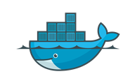
DOCKER COMPOSE
It is a tool used to define and run multi-container Docker applications
A Docker-Compose YAML file is used to configure all the containers used in an application
Then, a single command is used to create and start all the services
Docker Compose can be installed as follows:
Docker Compose
Windows and MacOS
Docker Compose is included in Docker Desktop
Linux
Visit the following link for installation: https://docs.docker.com/compose/install/

Slide 92
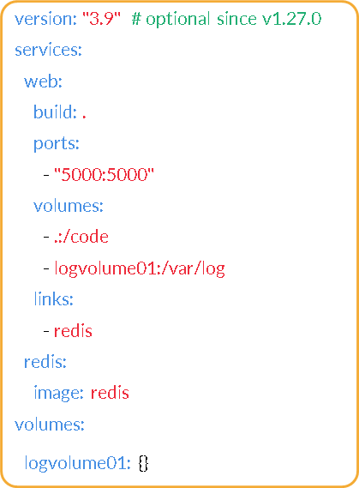
DOCKER COMPOSE FILE

Slide 93
BASIC DOCKER-COMPOSE COMMANDS
Command | Description
docker-compose up | Starts all the containers
docker-compose ps | Can be used to verify the status of running containers
docker-compose stop | Can be used to stop the containers
docker-compose logs | Can be used to check the logs of the containers
docker-compose down | Can be used to remove the containers

Slide 94
DOCKER-COMPOSE RESTART POLICIES
A mechanism to decide whether our containers start automatically or not when:
The container exits
The docker starts
It is advisable to use them in place of process managers
Restart policies can be classified into four types:
no
on-failure [:max-retries]
always
unless-stopped

Slide 95
DOCKER-COMPOSE “ENV VARIABLES” AND “DEPENDS ON”
Environment variables can be set in a service’s containers with the “environment” key
web:
environment:
- DEBUG=1
- KEY=VALUE
Depends on:
  It expresses the dependency between services
  Docker-compose up will start the services in the order of dependency. In the following example, the “db” container will begin before the “web” container:
web:
depends_on:
- db
db:

Slide 96
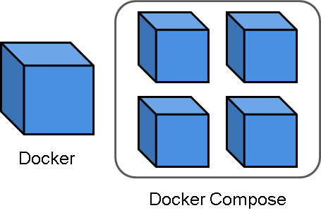
FEATURES OF DOCKER COMPOSE
Docker Compose has the following features:
Multiple isolated environments on a single host
Preserves volume data when containers are created
Recreates only the containers that have changed

Slide 97
DOCKER COMPOSE DEMO
Let’s set up a complete application using Docker Compose and see if it solves all of our problems
Voting application: https://github.com/dockersamples/example-voting-app

Slide 98
VOTING APP USING DOCKER COMPOSE
Voting App
Redis
Worker
Result App
Database
Node (Single Machine)

Slide 99
DEMO 14: DOCKER COMPOSE
Docker Compose concepts
Running multiple containers using Docker Compose
Deploying a voting application:
  https://github.com/dockersamples/example-voting-app
Issues with Docker Compose

Slide 100
Doubt-Clearance Window

Slide 101
Tasks to complete after today’s session
MCQs
Conceptual Questions
Project Checkpoint

Slide 102
Thank You!

